Slide 1
Energy Auditing of Fan and Blower System

Slide 2
Centrifugal Fan Applications
Handling materials
Shop ventilation
Transporting materials
Supplying combustion air
Discharging flue gases

Slide 3
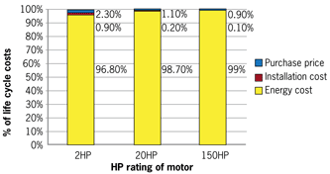
Life Cycle Costs
Siemens Study

Slide 4
Fan Types

Slide 5
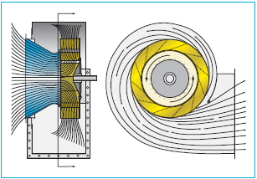
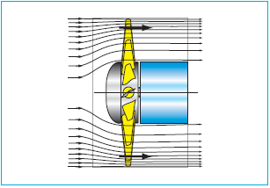
Flow in Centrifugal fan
Flow in Axial fan

Slide 6
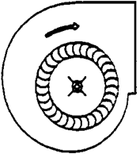
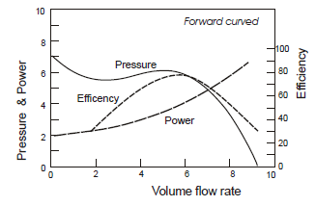
Centrifugal -Forward Curved
Blades curve in the direction of rotation
Low efficiency (between 55−65%)
Small and compact
Applications requiring low to medium air flows at low pressures
Clean air applications-HVAC

Slide 7
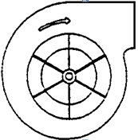
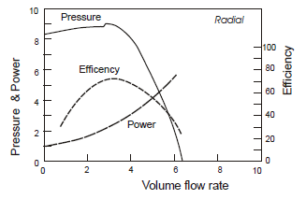
Centrifugal-Radial Bladed
Flat blade shape
High dust level applications- Pneumatic conveying
Applications requiring low to medium airflow rates at high pressures

Slide 8
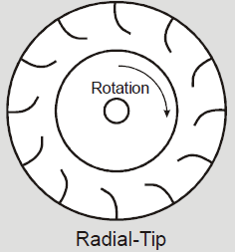
Centrifugal-Radial-tip
Low angle between incoming air and impeller blades – less turbulence than radial bladed
Efficiencies up to 75%
Airstreams containing small particulates at moderate concentrations, and airstreams with high moisture contents.

Slide 9
Centrifugal-Backward Curved
Blades curve tilt away from direction of rotation
Most efficient fan (~ 85%)
High volume at moderate pressure
Large HVAC applications

Slide 10
Centrifugal-Backward Inclined(Airfoil)
Blades curve tilt away from direction of rotation
Efficiency exceeding 85%
Clean air applications
Application - Forced-draft fans(boilers) and industrial dryer fans (furnaces)

Slide 11
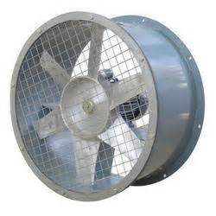
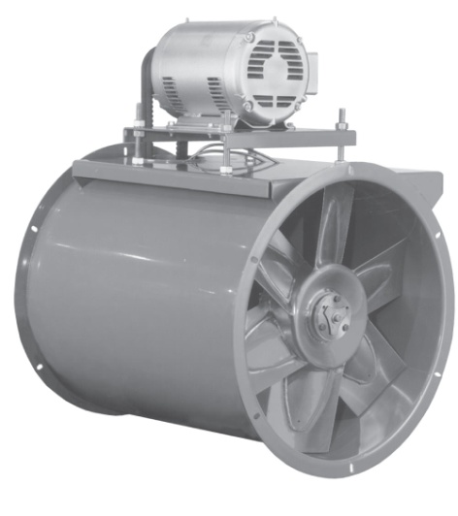
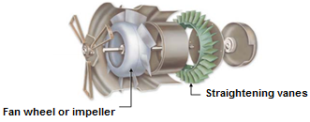
Axial Fan Types
Propeller Fan
Tube-axial Fan
Vane-axial Fan

Slide 12
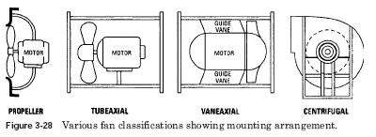

Slide 13
Features of Axial Fans
Compactness
Light weight
Low cost
Direct-drive units (operating at motor speed)
Belt-drive units (flexibility in fan speed selection)
Offers better efficiencies over wider range of duties

Slide 14
Applications of axial fans
Exhausting contaminated air or supplying fresh air
Unidirectional or reversible air-flow applications
Exhaust applications where airborne dust size is small, such as dust streams, smoke and steam

Slide 15
Fan Selection
Airflow
Static pressure
Temperature
Dust
Moisture
System layout
Cost
Availability
Plant personnel familiarity

Slide 16
Estimation of Airflow & Static Pressure
Airflow estimated based on user requirements
Static pressure
estimated based on pressure drops in various components:
Pipe size, length, bends, filter, equipment (e.g. waste heat recovery devise), etc. in the air flow path.

Slide 17
Static, Velocity and Total Pressures
Static Pressure
Static pressure is the pressure exerted on the duct walls.
Velocity Pressure
Velocity pressure is the kinetic energy of a unit of air flow in an air stream. It is also called as dynamic pressure. The velocity pressure depends upon both air velocity and density.
Total Pressure
Total pressure consists of sum of pressure the moving air exerts in the direction of flow (velocity pressure) and the pressure air exerts perpendicular to the air flow in the duct (static pressure).

Slide 18
Total vs. Static Efficiency
Total or mechanical efficiency
Comparing the performances of different fans
Work done in accelerating air to discharge velocity, and work done against static pressure
Static efficiency
Static efficiency neglects the velocity pressure imparted to air and considers only the flow delivered against the static pressure.
E.g., the larger the diameter of fan selected, lower will be the velocity pressure with consequently lower wasted power, and higher fan static efficiency.

Slide 19
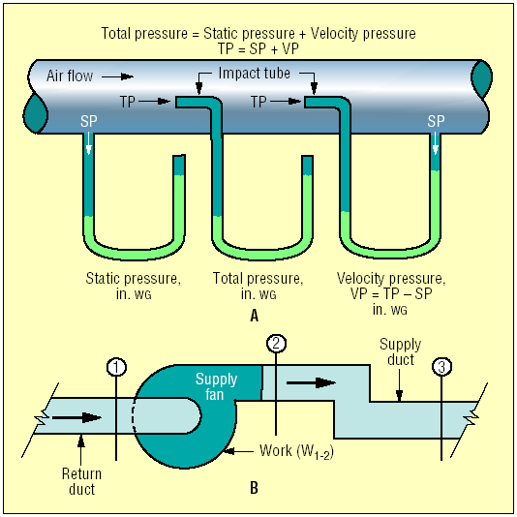
Relationship between Velocity, total and Static Pressures
P_{V} = P_{T} - P_{S}
Where,
P_{V} = Velocity Pressure
P_{T} = Total Pressure
P_{S} = Static Pressure
If velocity pressure is measured, velocity can be calculated and air flow can be determined.

Slide 20
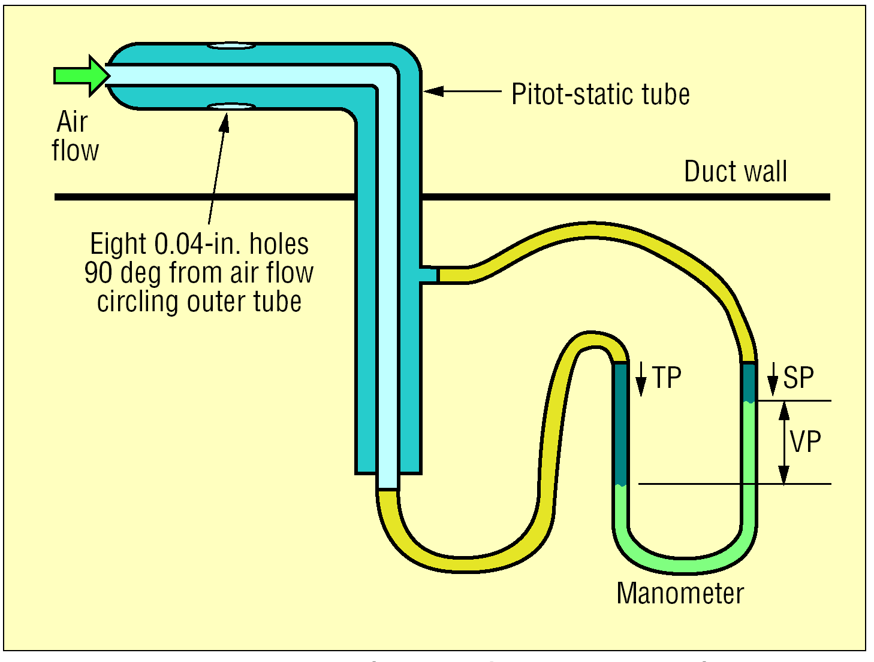

Slide 21
Flow Measurement
Calculation of velocity =
Where,
Cp − The pitot tube coefficient (take manufacturer’s value or assume 0.85)
Δpv −The velocity pressure measured using pitot tube and inclined manometer at each point (traverse point) over the entire cross-section of the duct, mm water column
γ − Gas density at flow conditions, kg/m³

Slide 22
Calculation of Density
Where,
P – Absolute gas pressure, mmWC
M – Molecular weight of the gas, kg/kg mole (in the case of air M = 28.92 kg/kg mole)
R – Gas constant, 847.84 mmWC m³/kg mole K
T – Gas temperature, K

Slide 23
Calculation of Velocity and Flow rate
Average velocity = V₁ + V₂+…V_{N}
Total number of traverse points
Where V_{N} is the velocity at the Nth traverse point
Airflow (Q), m³/s = Average velocity, V (m/s) x Fan duct area (m²)
Measure flow at various operating conditions and not one flow

Slide 24
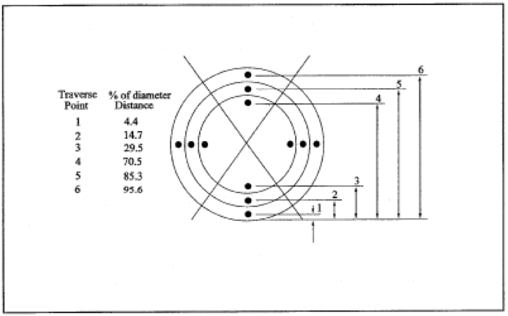
Traverse points

Slide 25
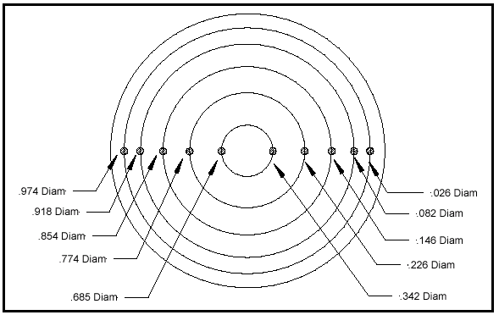
TRAVERSE POINTS FOR VELOCITY MEASUREMENT

Slide 26
Fan Shaft Power
Fan Shaft Power, kW or
Fan Break Horse Power (BHP)
= Fan motor power, kW x Motor Efficiency, η_{m}

Slide 27
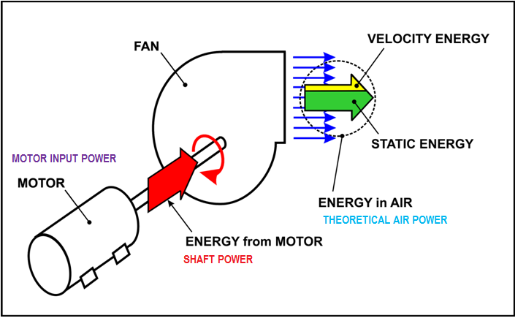

Slide 28
Fan Efficiency-Total & Static
Fan Total Efficiency η_{mech} % = Airflow in m³/s x ΔP (Total Pressure) in mmWC
102 x Fan Shaft Power in kW
ΔP (Total Pressure) = Discharge Total Pressure – Suction Total Pressure
Fan Static Efficiency η_{static}, % = Airflow in m³/s x ΔP (Static Pressure) in mmWC
102 x Fan Shaft Power in kW
ΔP (Static Pressure) = Discharge Static Pressure – Suction Static Pressure

Slide 29
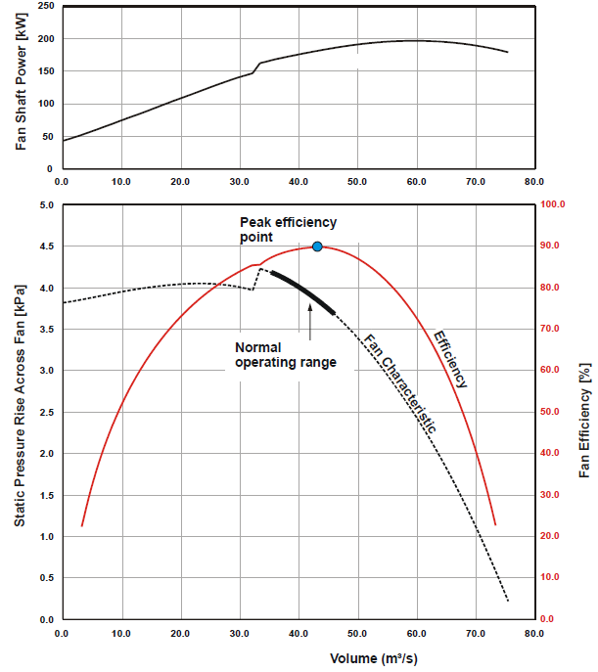
Fan
Performance
Curves

Slide 30
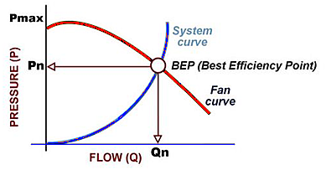
Fan System Curve
Sum of all system components:
Ductwork
Elbows
Transitions
Filters
Coils
Dampers / Louvers
Building pressure
Ps = k * CFM²
Pressure Increases with the Square of CFM!

Slide 31
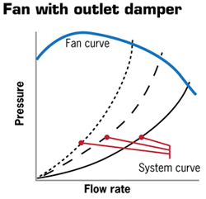
Flow Control - Damper
Throttles the air entering or leaving the fan
Control airflows in branch ducts of a fan system, or at points of delivery
Creates restriction in airflow- cause pressure drop and waste energy
More pressure drop−less flow

Slide 32
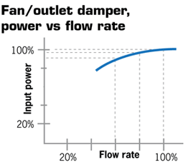
Outlet dampers have a relatively small effect on input power

Slide 33
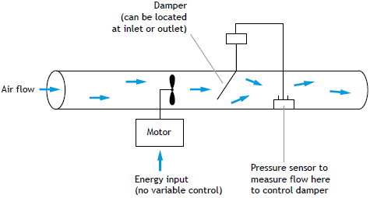
Flow Control by Outlet / Discharge Damper

Slide 34
Flow Control – Variable Pitch Fans (Axial Fans)
Varies flow by adjusting fan blade angle of attack with respect to the incoming airstream
Highly efficient as fan output is matched with system demand
Allows the fan to operate over a wide range of flows
Reduces start-up load on the motor
Provides constant motor speed operation.

Slide 35
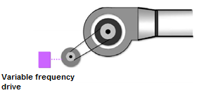
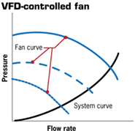
Flow Control –VFD
Close match between the fluid energy required by system and energy delivered by the fan
Uses electronic controls to regulate motor speed which in turn adjusts the fan speed to meet the demand
VFD controls the frequency of the power supplied to the motor to establish its operating speed.

Slide 36
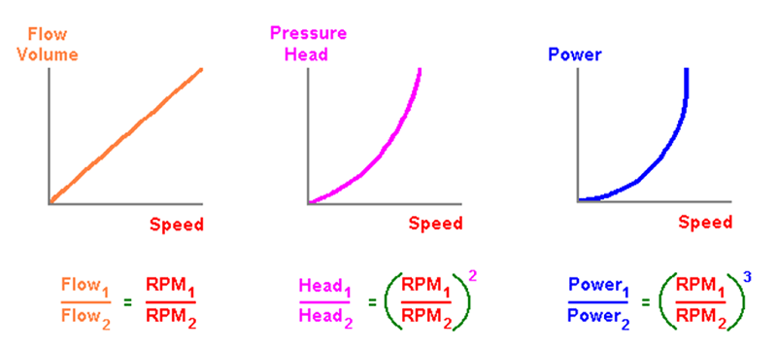
Affinity Laws

Slide 37
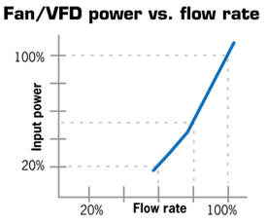
VFD closely matches the system curve and optimal input power for the desired flow

Slide 38
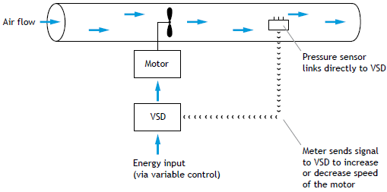
VFD Application
Data and Information
Flow and pressure requirements of the system in relation to the main business driver (e.g. production).
Fan type, make, flow rate, pressure, rated efficiency, motor rating in kW, motor efficiency, control method, drive system, pulley diameters (fan & motor) if applicable.
Production run-hours and system demand over the full range of plant operating conditions.
Other inter-related information depending upon the application (say AHU specifications, heat exchangers, driers, cooling tower capacities, combustion air requirements for boilers).

Slide 39
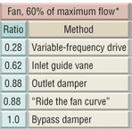
Savings with VFD instead of Damper Control
EXAMPLE
A 60-HP fan motor operates 24 hr a day, or 8,760 hr a year, “Damper control” for variable-volume control.
60 HP × 0.746 = 44.76 kW
0.88 ratio × 44.76 kW = 39.39 kW – damper control
0.28 ratio × 44.76 kW = 12.53 kW – VFD control
Savings: 39.39 kW - 12.53 kW = 26.86 kW
Annual Savings:
26.86 kw₄ × 8,760 hr × Rs. 6 per kwh =
Rs.1411761.6 (Rs. 14.1 Lakhs)

Slide 40
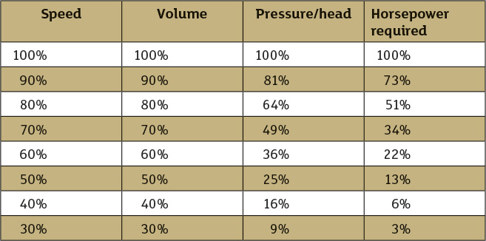

Slide 41
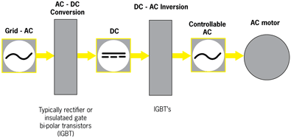
VFD Concept

Slide 42
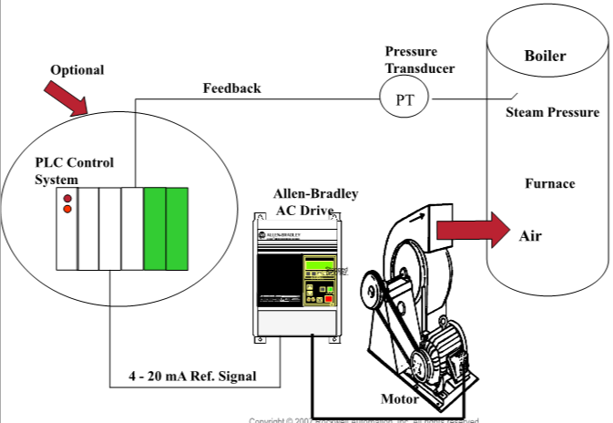
VFD for Boiler FD Fan

Slide 43
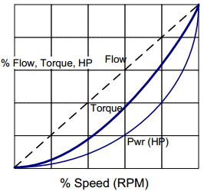
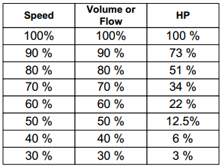
At 50% flow , HP required is 12.5%
0.53 = 0.125 = 12.5%

Slide 44
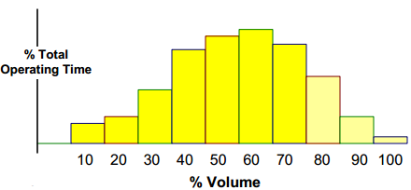
Duty cycle
70 % flow over 90 % of the time

Slide 45
Speed Reduction – Changing Motor or Fan Pulley
Fixed speed reduction
For a 50 mm reduction in pulley diameter, say from 200 mm to 150 mm, energy savings is 12 kW savings.
This method is not applicable for direct motor-driven fan.

Slide 46
Fan Replacement
Fans normally oversized during design
Oversized fans deviate far from BEP
Oversized fan generate higher pressure for the same flow
Visual signs of over sizing
Almost closed dampers and inlet guide vanes
Study if entire fan-motor can be replaced OR atleast fan can be replaced

Slide 47
Energy Auditing of Fan System
Instruments and Measurements
Power: kWh meter (with data logging capability to record kW and kWh usage).
Pressure: U-tube manometer, inclined tube manometer.
Temperature: Mercury thermometer, temperature probe.
Speed: Tachometer.
Flow: Pitot tube with inclined tube manometer or digital manometer.

Slide 48
Energy Auditing of Fan System
Field Audit
Prepare duct layout diagram showing duct size, transition, bends, and curves.
Observe damper position.
Measure fan electrical power consumption using power analyser/motor electrical logging over extended period, especially for variable-flow applications.
Measure fan differential pressure.
Measure flows using pitot tube and manometer (or alternative measurements such as temperature rise across a water-to-air heat exchanger where input energy and flow can be accurately recorded).
Measure distribution of air flow.
Measure pressures at points of demand.
Measure filter pressure drop, duct static pressures at various points.
Observe leakage if any.
Record duct size, transition, diffusers, and corners.

Slide 49
Energy Auditing of Fan System
Analysis
Assess the appropriateness of each air demand.
Possible reduction of flow.
Potential reduction in air leaks.
Assess isolation of air users.
Assess whether extraction systems is delivering the requirements at each of the locations.
Flow balance.
Assess deviation from operating point (10–15 % is acceptable).
Avoiding damper operation through energy efficient alternatives.
Assess fan efficiency and compare with design and fan system efficiency.
Assess fan inlet and outlet conditions for flow disturbance.

Slide 50
Energy Auditing of Fan System
Report
Describe briefly the fan system based on the details collected .
Analysis of fan system based on the field observations and audit.
Mention ENCON opportunities with potential savings, investment, and simple payback period

Slide 51
ENCON Opportunities in Fan Systems
Operational and Housekeeping Measures
Turn off fan when it is not needed
Clean filters and reduce pressure drop across them.
Check and adjust belt tension (motor-fan) regularly.
Arrest any leaks in the duct.
Clean fan blades regularly.
Check flow balance.

Slide 52
ENCON Opportunities in Fan Systems
Low-Cost Measures
Reduce fan speed by changing motor or fan pulley.
Consider impeller change where applicable for fixed flow applications.
Improve fan inlet and outlet duct connections to ensure proper flow distribution and losses at the inlet and outlet.
Explore use of low-slip belts such as flat, cogged belts.
Avoid damper operation through speed control (motor/fan pulley change).

Slide 53
ENCON Opportunities in Fan Systems
Retrofit Measures
Avoid damper operation through speed control (inlet guide vane/VFD) to adjust for changes in system requirements. Reducing a fan’s speed by 20% can reduce its power requirements by nearly 50%.
Replacing existing fan with energy efficient fan operating closer to BEP.
Review and increase duct size if feasible. A 15% increase in duct diameter can reduce pressure drop by 50%. This allows smaller fan motor to be used.
Use smooth, well-rounded air inlet cones for fan inlet air intakes.
Reduce bends in the ductwork.
Replace fan motor with energy efficient motor.
Replace oversized motors.
Replace outdated equipment with newer and optimal sized units.
Use energy efficient aerofoil backward curved fans if feasible.
Use simulation tools like Computational Fluid Dynamics (CFD) to improve fan systems.
Switch over to FRP blades in cooling tower fans.

Slide 54
Dust Collecting System
Cyclone
VFD
75 hpx1No
30 hpx3 No blower
Pneumatically
actuated dampers
Existing:
No dampers, Suction remains even when M/c not operating
Common suction and Unbalanced parallel operation
Proposed:
Provide dampers
Install Single Fan of 75 hp with VFD

Slide 55
1-Energy Saving in Dust Collecting System
Existing condition | For each section 3 dust collectors are installed with 30hp motor each. Provided common inlet suction to all blowers Motors are always running under 50% loading condition. The existing parallel operations of three blowers of each section are unbalanced
Proposed condition | Install a single blower with 75hp motor in-place of 3x30hp blowers and avoid parallel operation. Provide damper for closing when there is no work on particular section Provide VFD control.
Existing: For 30hp motors x3No
Energy consumption for each motor at 50% loading = 14.5kWh
Annual energy consumption =7,280x14.5x3 fans = 3, 16,680 kWh/year
Proposed: for 75hp motorsx1No and Standby
Energy saving potential-About 30% saving by operating blower at Best Efficiency Point
Annual Energy saving potential = 316680kWh/yearx0.3 = 95004 kWh/year
Annual cost saving in Rs. = 95004x4Rs = 3.8 lakhs/year
Investment for dampers, new motor, VSD = 6 lakhs
Investment for 8 set of collectors =8x6 lakhs = 48 lakhs
Total saving for 8 set of collectors =3.8*8 = 30.4 lakhs
Payback period = 1.6 year

Slide 56
Savings with VFD instead of Damper Control
EXAMPLE
A 60-HP fan motor operates 24 hr a day, or 8,760 hr a year, “Damper control” for variable-volume control.
60 HP × 0.746 = 44.76 kW
0.88 ratio × 44.76 kW = 39.39 kW – damper control
0.28 ratio × 44.76 kW = 12.53 kW – VFD control
Savings: 39.39 kW - 12.53 kW = 26.86 kW
Annual Savings:
26.86 kw₄ × 8,760 hr × Rs. 6 per kwh =
Rs.1411761.6 (Rs. 14.1 Lakhs)

Slide 57
Thank you

Slide 58
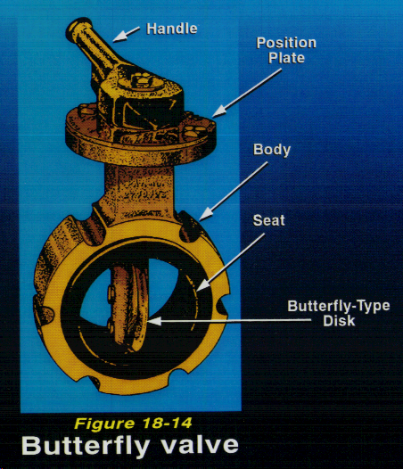
ButterflyValve
Used in ventilation systems
Adv: small, light-weight, & quick-acting
Disadv: leaks early & only low-flow throttle
Pressure loss coefficient =0.88

Slide 59
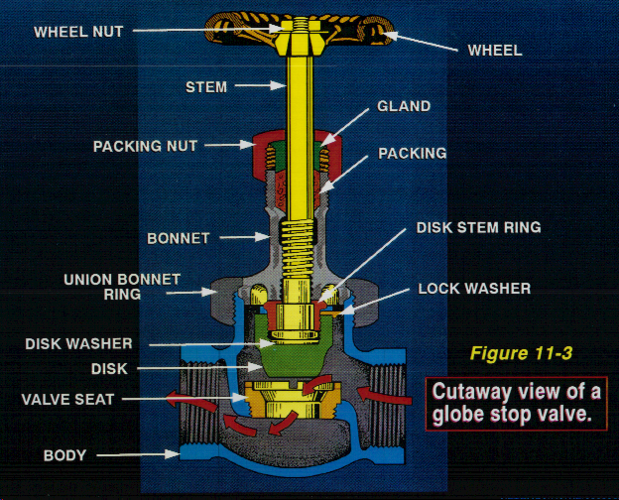
Globe Valve
Most common type of throttling valve
Disc attached to valve stem rests against seat to shut off flow of fluid
Disadv: High flow resistance
Pressure loss coefficient =28.55

Slide 60
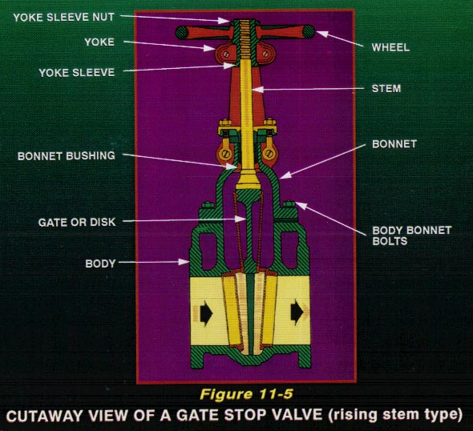
Gate Valve
Used when there must be straight-line flow of air with minimum resistance
Gate usually wedge-shaped or a vertical disc
Adv: No flow restrictions
Disadv: poor throttling
Pressure loss coefficient =0.66

Slide 61
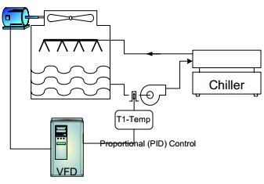
Typical VFD application (Cooling tower)

